Slide 1
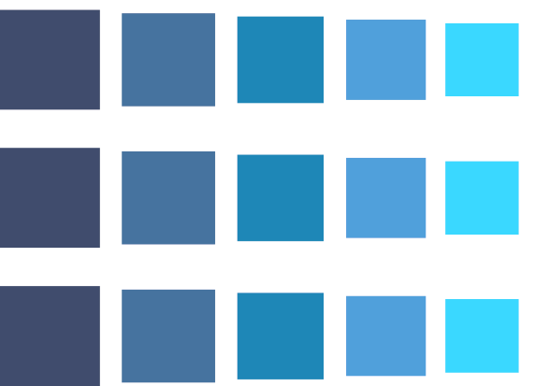




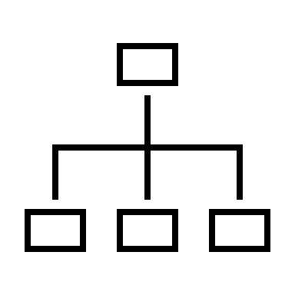
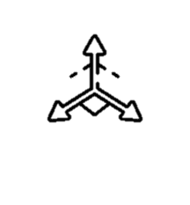





Backward Compatibility in Face Recognition
Shai Yehezkel and Lior Dvir Supervised by Elad Hirsch
Introduction
Visual recognition and retrieval systems are widely used in out lives, such in:
Frictionless physical access systems (Apple ID).
Missing person search.
Global Place Recognition.
Homeland Security applications.
Deep Neural Networks architectures progress fast.
Addressing queries in the new architecture w.r.t to the old architecture gallery is called the Cross Model Compatibility.
Preliminaries
Embedding Vector – a deep feature vector as an output of a NN (W\O Classification).
Embedding Space – The space spanned by embedding vectors.
Manifold – A hyper-surface in the embedding space where all embedding vectors reside.
Recognition - Querying an embeddings gallery by a vector and successfully retrieving a label.
Different networks have different embedding space and manifold.
NN
Embedding Vector
NN
Embedding Space
$$V=(x_{1},x_{2}…x_{n})$$
NN #1
Embedding Space A
Alice
NN
Embedding Vector
Search (Nearest Neighbor)
$$V_{2}$$
Person is Alice
Gallery Embeddings A
$$V_{1}$$
Query
Gallery Embeddings
NN #2
Embedding Space B
Gallery Embeddings B
$$V_{3}$$
Previous Work
Our work is based on a research by Wang et al.
Previous work suggests creating a unified transformer both to the new embedding space and original gallery embeddings.
Goal
We shall focus on implementing a transformer from the new embedding space into the original gallery embeddings.
We shall improve the transformer by adding new loss functions to our problem.
We shall augment our sample space via interpolation.
NN #1
Embedding Space A
Search (Nearest Neighbor)
Gallery
Embeddings A
NN #2
Embedding Space B
Transformer
Embedding Space A'
Project Sponsors:

